Slide 1
Path Robustness Research Ideas
Jon Minton

Slide 2
Problem/Opportunity
PSA is required, but not used to assess the robustness of the efficiency frontier: more could be done with the evidence already available
Use of deterministic numbers alone, combined with lack of formal indifference rules, means that when two options are really identical, whether one option is ruled out by extended dominance can be entirely random
The problem gets worse when:
There are many ‘me too’ drugs with similar actions etc;
There are MTCs;
There are many sequences under consideration
Patient and clinician choice may be being restricted for completely arbitrary reasons, without any increase in overall healthcare efficiency
The problem is partially technical: calculation of frontier is not automated, so calculating it for each PSA run is labour intensive
I have automated this process (described below). The next challenge is develop rules/heuristics for interpreting the results and standardising decisions about when/if to be indifferent between two or more options or efficiency frontiers.
The aim: A ‘New CEAC’ – a widely used addition to the standard health economic methodological toolkit.

Slide 3
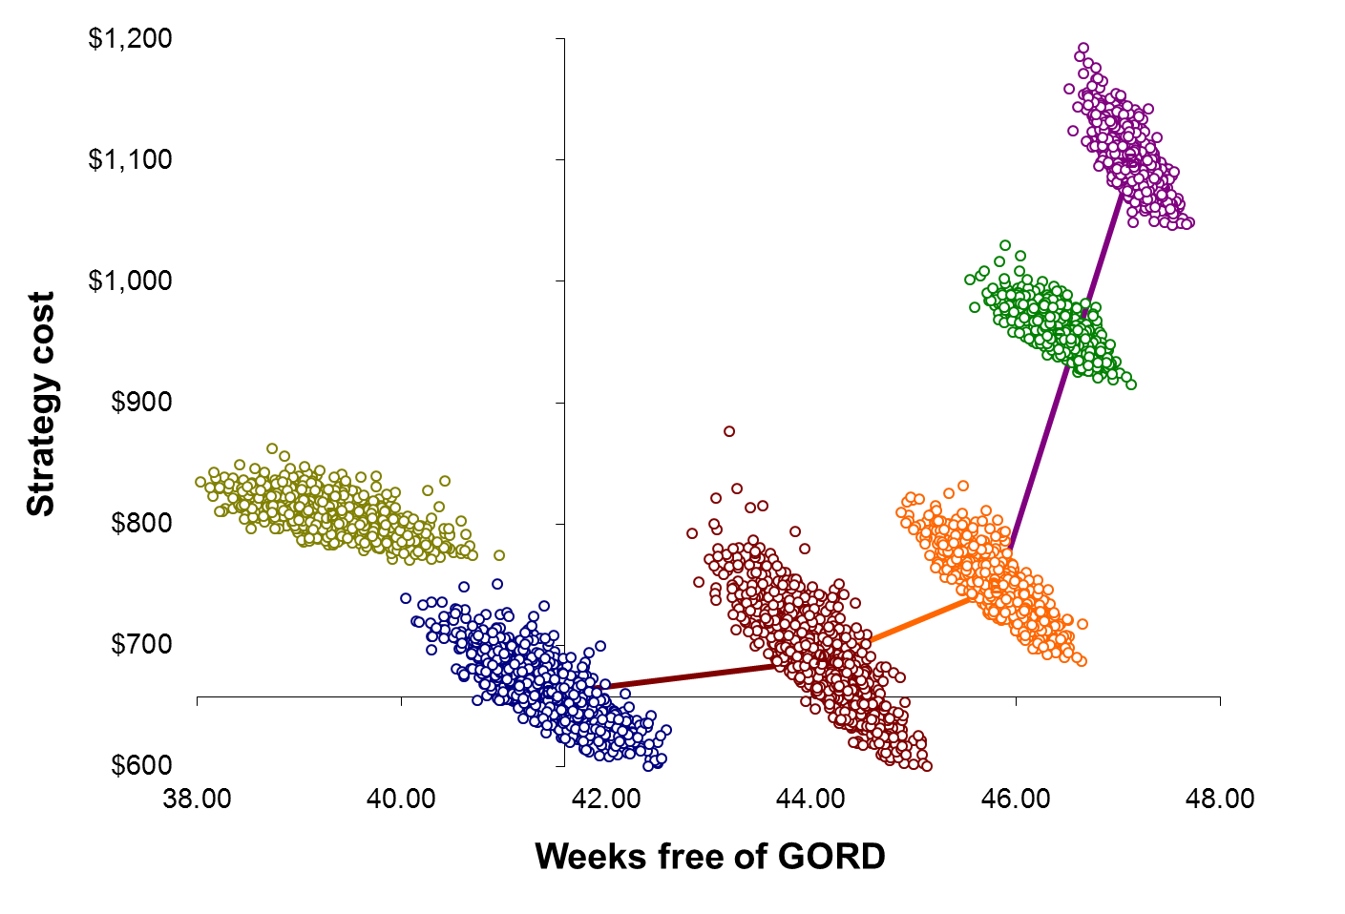
B
F
D
E
A
C
Notes:
These are PSA scatterplots for the Briggs GERD/GORD model used pedagogically in Briggs, Claxton and Sculpher’s book, and elsewhere, to concepts like PSA and decision uncertainty.
The frontier is illustrated by the lines, and goes through options C_A_E_B.
Although the model is often used to illustrate PSA, it does not formally consider how uncertainty in the true joint value of an option leads to uncertainty in the frontier.
To do this requires calculating the frontier for all PSA runs, which requires automating the process of identifying the efficiency frontier.

Slide 4

Convert from Cartesian coordinate system
$$f\left(x_{b},y_{b}\right)−f(x_{a}, y_{a})$$
To Polar coordinate system:
$$g(θ_{ab},d_{ab})$$
Distance Matrix
Angle Matrix
Knowing
Angle Matrix
lowest cost option
allows calculation
of efficiency frontier
Notes:
A key insight required to automate the process is that distances between points can be represented as either Cartesian or Polar coordinate systems.
The Polar coordinate system represents distances between points using two matrices, which I call an Angle Matrix and the Distance Matrix.
The Angle Matrix contains all the information necessary to calculate the efficiency frontier for any PSA run.

Slide 5
Angle blocks to efficiency frontiers
 | A | B | C | D | E | F
A | NA | 89.5757 | 264.5271 | 92.30135 | 88.34255 | 89.50518
B | 269.5757 | NA | 269.2552 | 268.4668 | 269.7842 | 269.7099
C | 84.5271 | 89.25524 | NA | 90.82703 | 87.12455 | 89.0387
D | 272.3014 | 88.46677 | 270.827 | NA | 276.2395 | 87.29949
E | 268.3426 | 89.78423 | 267.1246 | 96.23953 | NA | 89.83432
F | 269.5052 | 89.70992 | 269.0387 | 267.2995 | 269.8343 | NA
Lowest cost
Option C
All angles > 90 degrees so stop
Starting at the lowest cost option, option C, the column on that row with the smallest angle is option A, so the first part of the frontier is C_A.
From option A, the column on that row with the smallest angle is option E, so the frontier is now C_A_E.
From option E, the column on that row with the smallest angle is option B.
No option in row B has an angle less than 90 degrees, indicating that it is the end of the frontier.

Slide 6
Path | Prop
CAEB | 0.334
CEB | 0.253
AEB | 0.148
CAEFB | 0.116
AEFB | 0.075
CEFB | 0.052
AFB | 0.013
AB | 0.001
Notes:
This graph shows contour representations of the distribution of PSA for each of the GERD options.
Contours indicate positions with equal ‘heights’ of something along a two dimensional surface. They might be heights in a map, but in this case they are densities of estimates.
10,000 rather than 1,000 PSA runs are used: If a scatterplot were used, there is a perverse disincentive to conducting more runs. This is because the image will become saturated with dots and so it will become impossible to see the shape of the uncertainty. If contour plots are used then using more PSA runs will just produce ever more accurate contours.
The contours are at fixed heights, so if an option has more contours bunched together, then it indicates a greater concentration of values. (For example, note A has one contour whereas option B has four.)
The table in the top left indicates the distribution of Efficiency Frontiers identified by each of 10,000 PSA runs.
33.4% of runs identify the deterministically chosen frontier: CAEB.
The next most common frontiers identified are CEB (25.3%) and AEB (14.8%).
This information can be used to estimate:
The robustness of the frontier as a whole;
The robustness of parts of a frontier (such as the proportion of frontiers containing CA compared with AE)

Slide 7
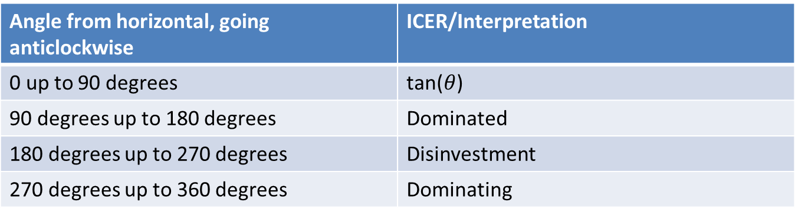
Interpreting Angle Blocks
ICERs are knowable directly from the angles in the Angle Block
A plausible ICER Credible Interval can therefore be calculated for each option:
assuming the ‘optimal’ frontier;
assuming other plausible candidate frontiers
Angle from horizontal, going anticlockwise | ICER/Interpretation
0 up to 90 degrees | tan($θ$)
90 degrees up to 180 degrees | Dominated
180 degrees up to 270 degrees | Disinvestment
270 degrees up to 360 degrees | Dominating

Slide 8
When two options are very similar
‘Anonymised’ visual inspection
Informal: eyeballing
Formal: Cluster analysis (Confusion matrices)
Net-benefit league table density plots
Re-running analysis with/without assumption of indifference and evaluating increase in path robustness/reduction in misclassification
Stopping when robustness above an acceptable threshold
Notes:
If two options are very similar, then if someone is shown PSA scatterplots showing PSA runs for all options, but without identifying information (e.g. same colour for all options), and are then asked to guess how many options are being compared, then they are likely to guess one fewer option than the true number (e.g. 6 options rather than 7). This could suggest that two options overlap each other so much they should be treated ‘as if’ they are one option.
Cluster analysis can do the same but more formally. If there are K treatments than an algorithm can be told to divide the scatter into K separate groups. If a lot of PSA from two or more treatments are shared between two clustered groups then this indicates a difficulty in distinguishing between options, and so again a justification for combining options.
There exist more sophisticated cluster analysis algorithms where the user does not have to specify the number of clusters into which the data should fall. If these suggest that the optimal number of clusters is fewer than the true number of treatments then again this suggests that options should be treated as equivalent.
Conditional on a given willingness-to-pay threshold, kernel density estimates of the range of plausible NHBs and NMBs of a particular option can be identified. These would look like the figure shown (but better). Strong overlap in density estimates of two or more options would again suggest that two options should be combined.

Slide 9
Opportunities
Two month option: A methods paper or two saying ‘this could/should be done’
One year option: Above + prospective/selective re-evaluation of some studies + some stakeholder engagement/elicitation about these issues
Three year option: above + systematic review and re-analysis of previous NICE HTAs/STAs etc where data are available + analysis of explanatory factors for differences in handling of these issues + substantial stakeholder engagement + development of easy-to-use tools and software.

